Slide 1
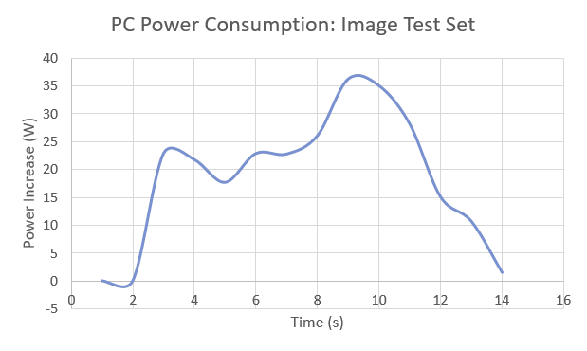
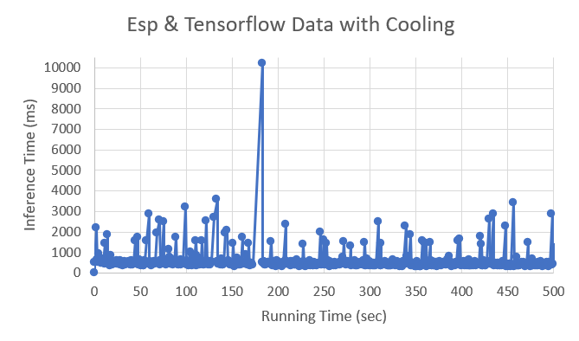
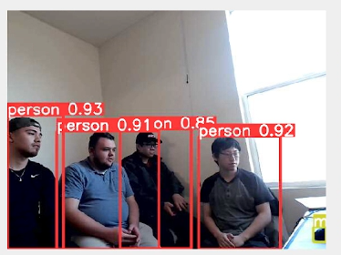
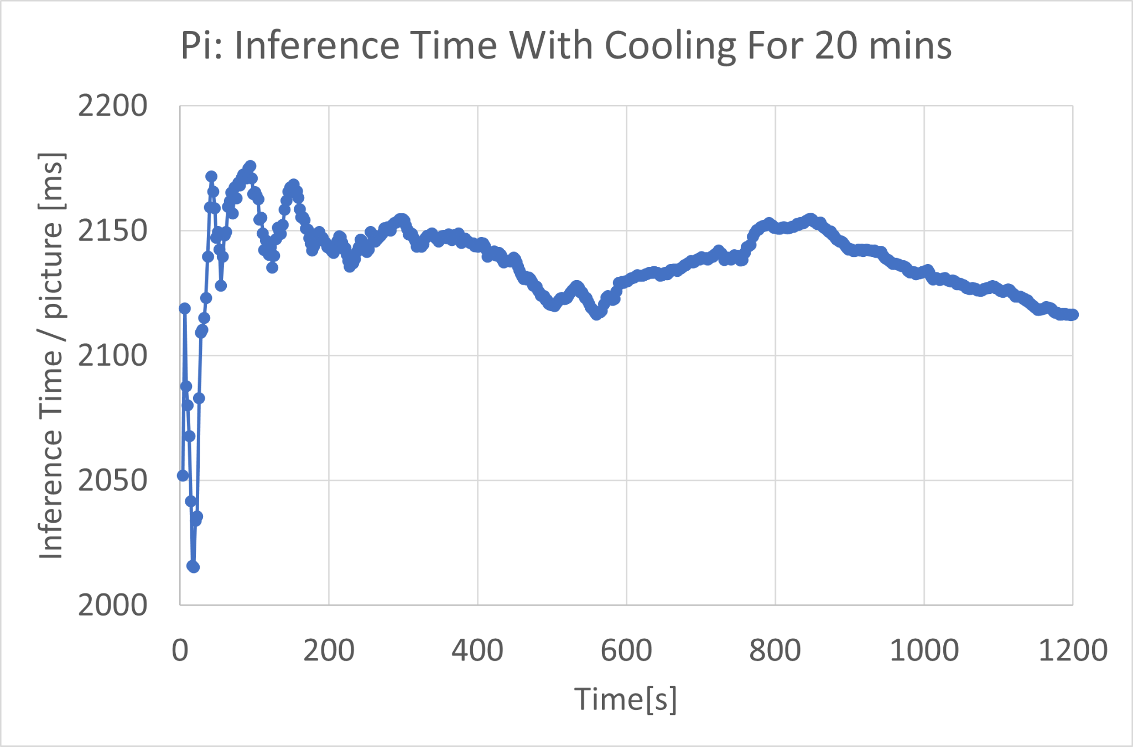
Evaluating Object Detection For Various Platforms
Kyler Martinez, Ruben Gutierrez, Austin Vinh Tran, Nelson Chong, and Mohamed El-Hadedy
Contact: kjmartinez@cpp.edu, rubeng1@cpp.edu, austinvinht@cpp.edu, nwchong@cpp.edu, mealy@cpp.edu
California State Polytechnic University, Pomona, Department of Electrical and Computer Engineering
Abstract
Computer vision has become an increasingly important field with an increase in object detection algorithms of varying capabilities. These algorithms require large amounts of computing and electrical power. These constraints become a concern as the device decreases in size and power constraints and processor resources must be considered. Many microcontrollers cannot execute algorithms like YOLOv5, but systems can use another device to process the object detection algorithm while the microcontroller performs other tasks. Each solution to this problem has flaws, but machine learning on small devices will become more accessible as technology develops.
Results
On the PC, the image and the camera testset performs very well. The camera performs with an FPS of about 125 while the image set performs with an FPS of 100.1. In addition, the amount of power needed for both are significantly different with the image test requiring more power than the camera test.
On the laptop, the image testset performs better than a live camera feed with 4.81 FPS, but at the cost of more power consumption.
On the Raspberry Pi, YOLOv5 is impractical because it processes images at .46 FPS at best. Greater performance and stability was found with cooling.
The ESP32 micro with the TensorFlow algorithm performs at an average 1.90 FPS at best. While the ESP32 micro with YOLOv5 on the desktop PC performs at an average 6.04 FPS.
Conclusion
YOLOv5 is powerful when applied to problems that requires computer vision, but is computationally intensive. Modern PCs have the capabilities to process frames and perform inferences fast enough to be useful in many applications. On the other hand, YOLOv5 underperforms on microprocessors such as the Raspberry Pi, and is infeasible for many microcontrollers. An alternative for these devices is to run a less intensive algorithm such as TensorFlow lite. It is possible to implement YOLOv5 on the microcontrollers by streaming the video feed from the microcontroller, and process it on another machine. However, this method accrues additional costs and forces internet constraints that bottlenecks the overall system.
Metrics & Methods
Performance metrics are important in making trade-offs from the designer’s and purchasing perspective. The metrics used are inference time, frames per second, and power consumption. Inference time is the time it takes for forward propagation in milliseconds. The inference time is calculated by dividing FLOPs by FLOPS, where FLOPs is the number of floating point operation, and FLOPS is the number of floating point operations per second. The frames per second is the inverse of the inference time. To measure power consumption, a KUMAN Power Meter KW47 is used for the Raspberry Pi and ESP32 microcontroller, and a software called Core Temp is used for the PCs. To measure power consumption, take the difference between the average power and the idle power. The power is measured in Watts.
References
1. Ultralytics (2022) YOLOv5 (Version 7.0) [Source Code]
2. FreedoomTechWeb (2022) YOLOv5Raspberry Pi 4 [Source Code]
3. TensorFlow (2022) TensorFlow (Version 2.11.0) [Source Code]
4. FreedoomTechWeb (2022) ESP32Cam Object Detection [Source Code]
5. KUMAN Power Meter KW47 User Manual, KUMAN. Accessed: Sep. 30, 2022. [Online].
6. Lauren Hinkel | MIT-IBM Watson AI Lab, “Tiny Machine Learning Design alleviates a bottleneck in memory usage on internet-of-things devices,” MIT News | Massachusetts Institute of Technology. [Online]. [Accessed: 26-Nov-2022].
7. M. Stewart, “Tiny Machine Learning: The next ai revolution,” Medium, 03-Oct-2020. [Online]. [Accessed: 26-Nov-2022].
8. D. Davies, “Yolov5 object detection on windows (step-by-step tutorial),” W\&B, 20-Sep-2021. [Online]. [Accessed: 26-Nov-2022].
9. J. Cohen, “How to optimize a deep learning model for faster inference?,” Think Autonomous, 19-Oct-2022. [Online]. [Accessed: 26-Nov-2022].
10. D. R. Parthasarathi, “Computer Architecture,” Performance Metrics – Computer Architecture, 24-Jul-2018. [Online]. [Accessed: 26-Nov-2022].
11. Core Temp. [Online]. [Accessed: 26-Nov-2022].
12. “Advantages and disadvantages of microcontroller,” Polytechnic Hub, Apr. 13, 2017. [Accessed Nov. 27, 2022].
13. IBM Cloud Education, “What is Machine Learning?,” IBM, Jul. 15, 2020. [Accessed Nov. 27, 2022].
14. M. Lab, “Microcontroller Memory Organization and Types - Explained with Memory Segments,” Microcontrollers Lab, Aug. 15, 2020. [Accessed Nov. 27, 2022].

